Slide 1
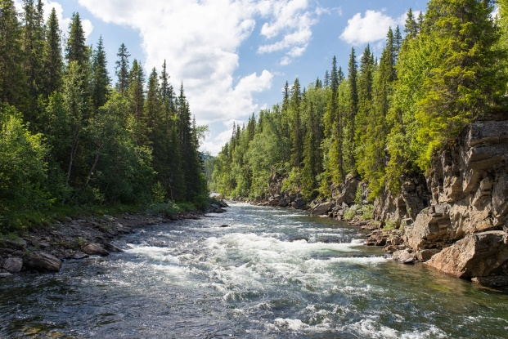
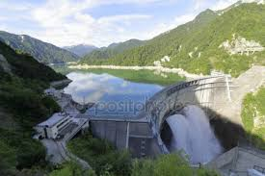
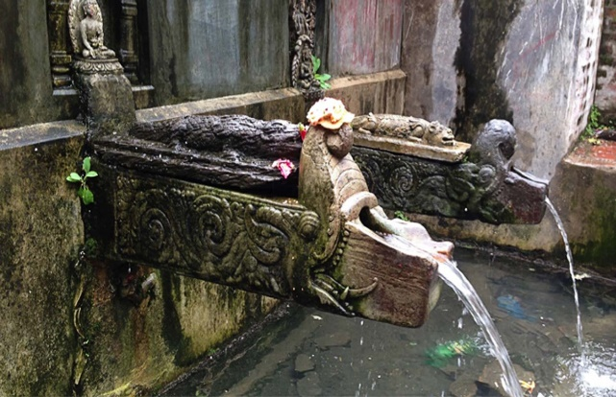

Sources of Water
Group Members:
Paras, 097
Parshuram, 098
Prabhakar, 099
Prabhat, 100
Prabindra, 101
Pradip, 102
Tutor:
Asst. Prof. Shukra Raj Paudel Department of Civil Engineering IOE, Tribhuvan University
2019-12-20

Slide 2
The Objective Of The Presentation Is To Familiarize Students About
Water cycle (Hydrological Cycle)
Types of surface water
Determination of the capacity of impounded reservoir
Types of groundwater
Rainwater harvesting
Optimal source of water resources for a specific area
1

Slide 3
Presentation Outline
Hydrological Cycle
Classification of Sources of Water
Surface Sources
i) Rivers
ii)Lakes
iii)Streams
iv)Ponds
v)Impounded Reservoirs
Ground Sources
Selection of Water Sources

Slide 4
Surface Sources
Ground Sources
Sources Of Water
Rivers
Springs
Lakes
Wells
Ponds
Infiltration Well
Impounded Reservoirs
Infiltration Gallery
3

Slide 5
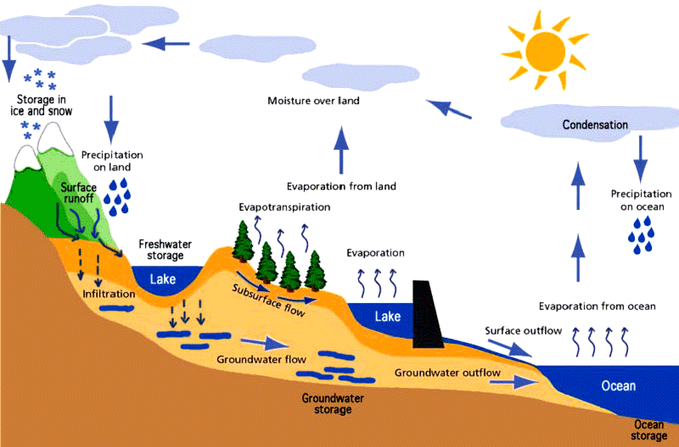
2.1 The Hydrological Cycle
Source: https://www.wordpress.com
4

Slide 6
Phenomena Of Hydrological Cycle
S.No. | Phenomenon | Definition
1 | Evaporation | Conversion of liquid water into gaseous state.
2 | Condensation | Conversion of vapour into liquid.
3 | Precipitation | Any form of water that falls in the earth surface.
4 | Infiltration | Absorption of water into soil layer.
5 | Runoff | Flow of precipitated water from higher to lower elevation.
6 | Evapotranspiration | Release of water vapour from plants into the air.
7 | Sub surface flow | Flow of water below the ground surface.
5

Slide 7
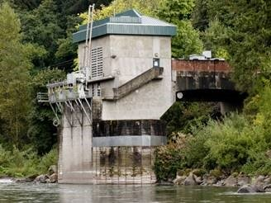
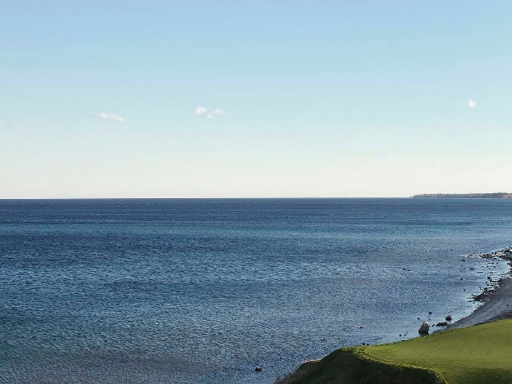
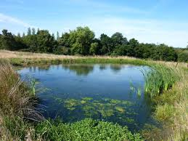
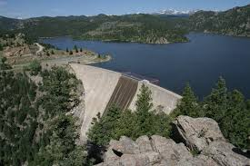
2.2 Sources Of Water
2.2.1 Surface Sources
Source: theconstructor.org
Source: www.wikipedia.org
Source: www.denverwatertap.org
6
Source: www.tr3dent.com

Slide 8
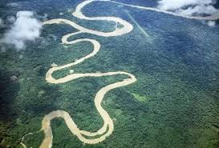
Rivers
A river is a natural channel that carries surface runoff from higher elevation to a lower elevation
It receives runoff from a catchment area or a runoff basin
The size of river depends upon the number of tributaries, as the number of tributaries increases, so does the size of the river
Source: www.ardeaprints.com

Slide 9
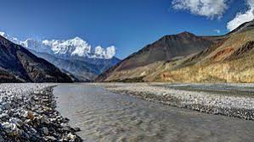
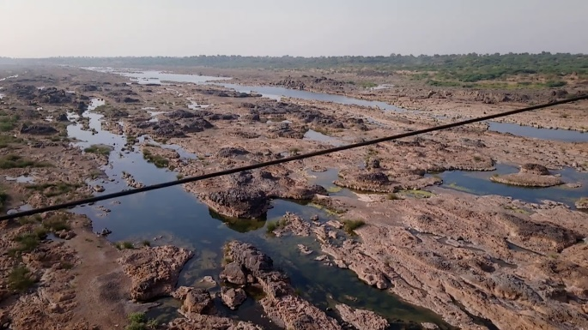
Types Of Rivers:
Perennial rivers:
Water is available throughout the year
Non-Perennial rivers:
Water is available only during the rainy and monsoon season
Source: www.wikipedia.org
Source: www.wikipedia.org
8

Slide 10
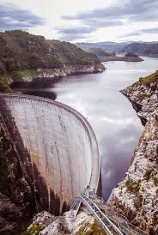
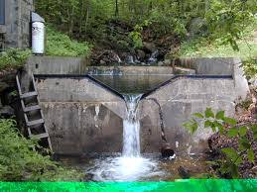
Hydraulic Structures Built Across Rivers
Fig: Dam
Fig: Weir
9

Slide 11
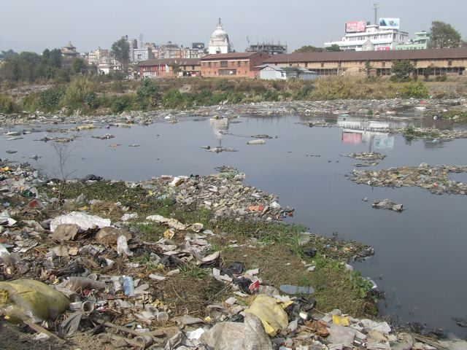
Quality of River/Stream Water
At higher altitude: Better quality
At lower altitude: Poorer quality due to settlement of sediments
Near populated areas and cities: worst quality due to pollution
Bagmati River
(Source: www.wikipedia.org)
Source: www.wikipedia.org
10

Slide 12
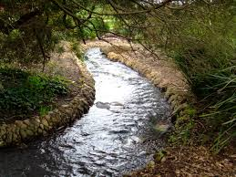
Stream
The natural drainage channel found in mountainous and hilly areas is known as stream.
It has a smaller width, depth and catchment area than a river.
The quality of water is relatively good in a stream except for the first runoff
Source: www.zoltanraffai.com
11

Slide 13
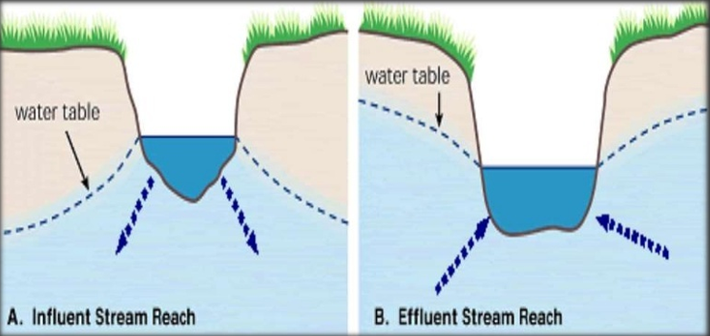
Types of Stream on the Basis of Groundwater Flow
Fig: Losing Stream
Fig: Gaining Stream
Source: www.cals.arizona.edu
12

Slide 14
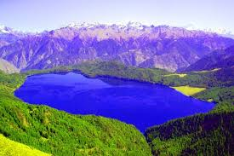
Lakes
A lake is known as a large natural depression that gets filled up with water.
A lake is generally found in mountainous and hilly area
Quality- depends upon the catchment characteristics
Quantity- depends upon the following factors:
1. Size of Lake
2. Catchment area
3. Total annual rainfall
4. Groundwater table
5. Perviousness of ground
Source: www.nepalhimalayatrekking.com
13

Slide 15
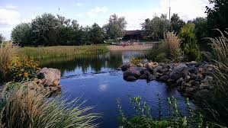
Ponds
Natural/artificial depression smaller than lake is known as pond
Contains poorer quality of water.
Must be properly treated before use
Usually only suitable for irrigation and livestock purposes
Source: www.healthypond.com
14

Slide 16
Impounded Reservoir
It is a reservoir constructed in the valley of a stream or a river in order to store water by holding the free flow of river.
Water storage can be beneficial if the supplied water is insufficient
Functions:
-Storage of water for future use
- Flood Control
Source: www.britannica.com
15

Slide 17
Location Of Reservoir
The location of impounded reservoir depends upon:
The quality and quantity of water available.
Existence of suitable dam site.
Size and elevation of the reservoir.
Density and distribution of population.
Geological condition of the proposed site.
16

Slide 18
Point Considered During Site Selection
of Reservoir
Narrow river channel but rapidly widening upstream.
The site should be located higher elevation than that of treatment plan
and distribution area.
The site should have availability of sufficient quantity of water .
Important infrastructure should not be submerged during construction.
Topography should be favorable for site & have sufficient construction material.
Flow
17

Slide 19
2.2.6 Calculation of Reservoir Capacity
There are mainly 2 methods:
Graphical method :
This method comprises of data plotted in a graph paper,
and finding the biggest distance between demand curve
and inflow curve.
Analytical method :
This is a mathematical approach to calculate capacity of an
impounded reservoir.

Slide 20
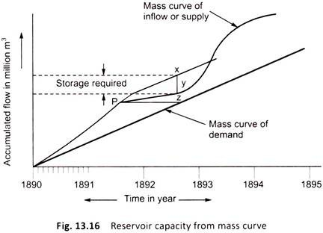
1. Graphical Method
Also called “Mass Curve Method”.
Mass curve is the graph plotted of time vs. accumulated flow.
In this method mass curve of inflow and mass curve of demand is plotted on the same graph.

Slide 21
The inflow plotted is usually a curve and demand is usually a straight line, but can be a curve too.
Slope of the curve gives their respective rate of flow.
If slope of inflow curve is more than demand curve, it means rate of inflow is more than that of demand and the opposite has greater rate of demand.
Time period in which inflow rate > demand rate is called wet period and where demand rate > inflow rate is the dry period.

Slide 22
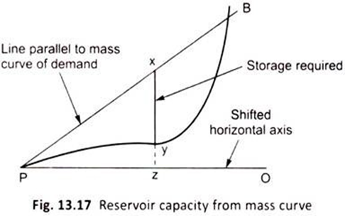
So, a tangent on inflow curve at the starting of dry period (point P in the mass curve zoomed in here) parallel to demand curve and is intersected at point B of the inflow curve.
The maximum intercept xy gives the required capacity of reservoir.
It is because the dry period is for which the reservoir is to be made as in this period, demand is higher than inflow.

Slide 23
So, the period starts from the point of tangent P, and ends at intersecting point B, intersection denoting the transition from dry to wet period.
It should be noted that inflow curve should lie under the tangent .
The maximum intercept denotes the maximum magnitude by which the demand exceed inflow, which should be stored in stored by the reservoir to meet demand.

Slide 24
2. Analytical Method
It is a easier and more accurate method than graphical method.
It calculates the capacity of reservoir using simple addition and subtraction which is shown as an example in the next slide.
Maximum Cumulative deficit
Total Inflow
Total demand
-
+
+
Maximum Cumulative surplus
Reservoir
Capacity
=

Slide 25
Sample Question
Q) The city has average water demand of 6260 million liters per month. Calculate the capacity of impounded reservoir. The flow in the river is shown.
Month | jan | feb | mar | apr | may | june | july | aug | sept | oct | nov | dec
Inflow(m³/s) | 2.97 | 1.99 | 1.00 | .00 | .51 | 1.00 | 2.00 | 3.00 | 4.00 | 5.00 | 4.00 | 2.80

Slide 26
Solution :

Slide 27
Solution(contd..)
Capacity of impounded reservoir=
maximum cumulative surplus + maximum cumulative deficit – total inflow + total demand
=1753.0+18652.0-74425.0+74424.0
=20404.0ML
26

Slide 28
Description of formula
In the formula, the maximum cumulative deficit is added to store water for the period with the driest time of the year.
The maximum cumulative surplus is added so that the excess water do not flood over the reservoir.
The total inflow is subtracted because that is the volume of water supplied throughout the year from source.
The total demand is added because it is the total volume of water that the population consumes.
27

Slide 29
2.3 Ground Water
Sources which exist below the ground surface.
The process in which the surface water infiltrates into the ground water and percolate deep into the ground and is stored as groundwater is known as groundwater recharge.
Recharge may be natural or artificial
Natural recharge include precipitation water flowing in stream and river lake and other natural water bodies.
Artificial recharge includes excess irrigation, seepage from canal leakage from reservoirs or tanks.

Slide 30
Infiltrated water percolate downward under the action of gravity until it is checked by impermeable layer and stored as ground water.
The surface of ground water exposed to atmospheric pressure is known as water table.
The ground water is moving in the lateral direction to some point of escape appearing as spring infiltration galleries or wells, or it reappears to join river lake or sea.
The occurrence of ground water and its transmission is largely depend on various water bearing formation.

Slide 31
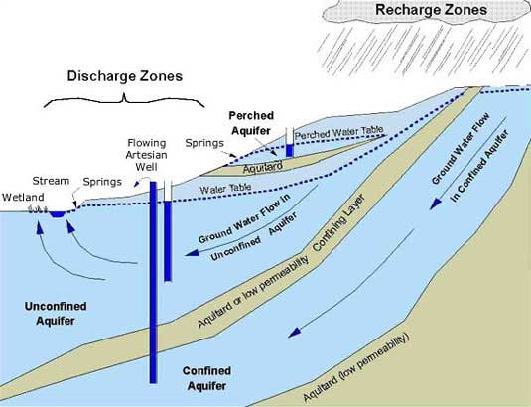
2.3.1 Types of Water Bearing Formations
i) Aquifer
A geological formation that contains sufficient permeable material which permits storage as well as transmission of water.
Example: unconsolidated sand gravel.
Types of aquifers
Confined aquifer
Unconfined aquifer
Perched aquifer
Source: imnh.iri.isu.edu
30

Slide 32
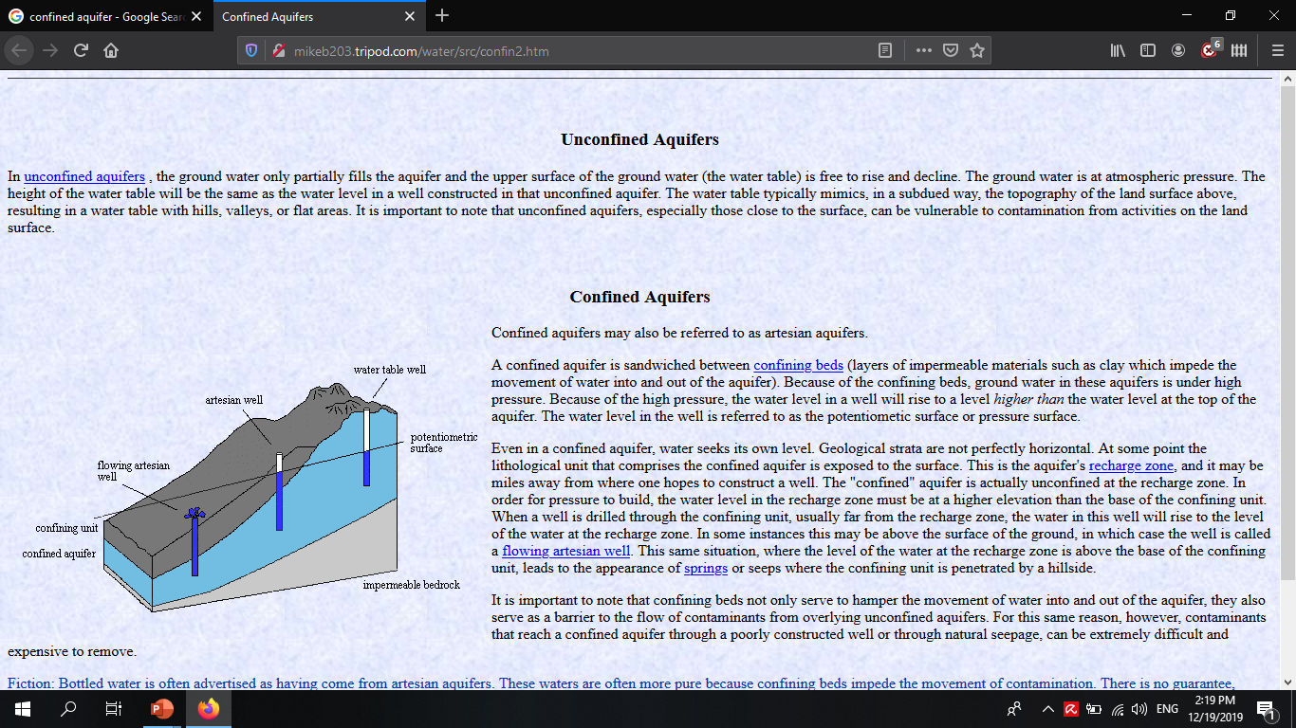
Confined aquifer
In such aquifer groundwater is confined under the pressure greater than atmospheric pressure by overlying relatively impermeable strata.
Also known as artesian aquifer.
Region supplying water to confined aquifer is recharge area.
In a well penetrating such aquifer the water will rise to the level of artesian head, or up to the piezometric surface.
Source: http://mikeb203.tripod.com
31

Slide 33
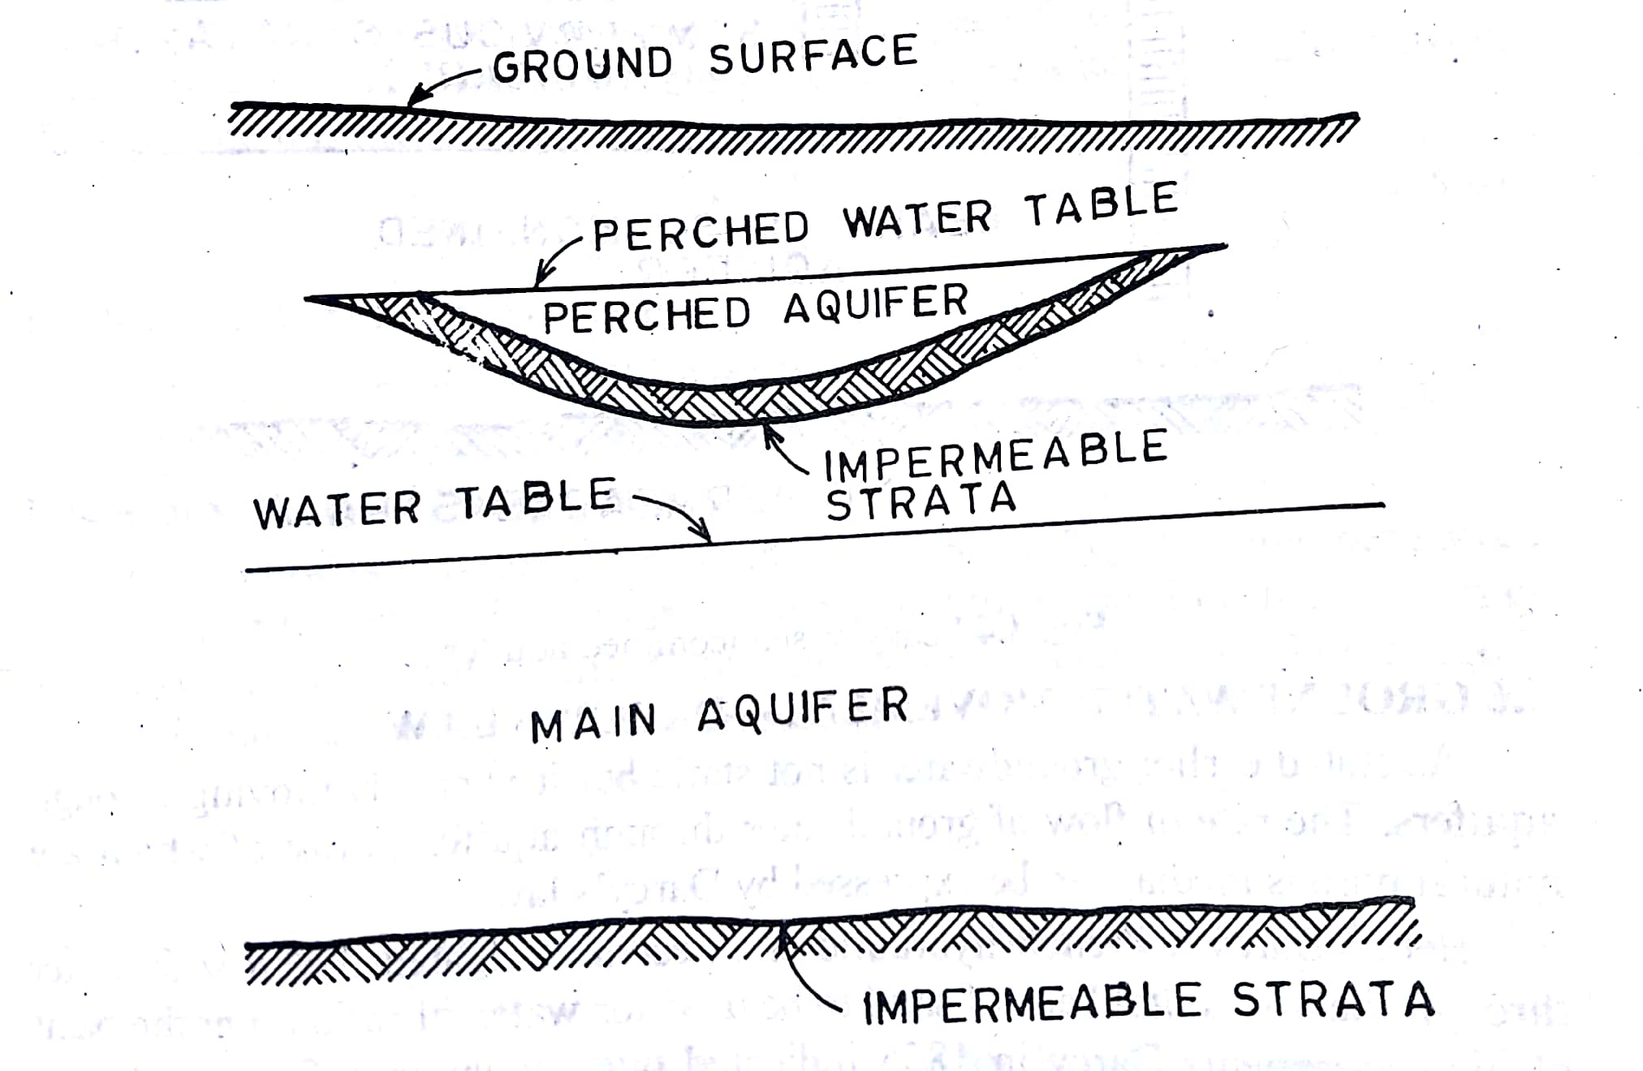
2. Unconfined aquifer
Water table forms the upper surface of zone of saturation.
Also known as non-artesian aquifer or water table aquifer.
Water table is not stationary surface it may rise or fall.
3. Perched aquifer
Occurs when small portion of water bearing strata is present in the zone of aeration above main body of groundwater.
Yield only small amount of water
it is temporary.
32

Slide 34
ii) Aquiclude
Formation of relatively impermeable material.
Permits storage of water but not yield sufficient amount of water.
Example : saturated clay.
iii) Aquitard
Formation of poorly permeable material.
Permits storage of water but obstruct groundwater movement and not yield water freely to well. Example : sandy clay.
iii) Aquifuge
Formation of relatively impermeable layer neither contains nor transmit water. Example: solid granite.
33

Slide 35
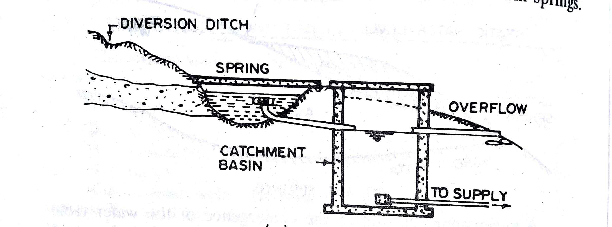
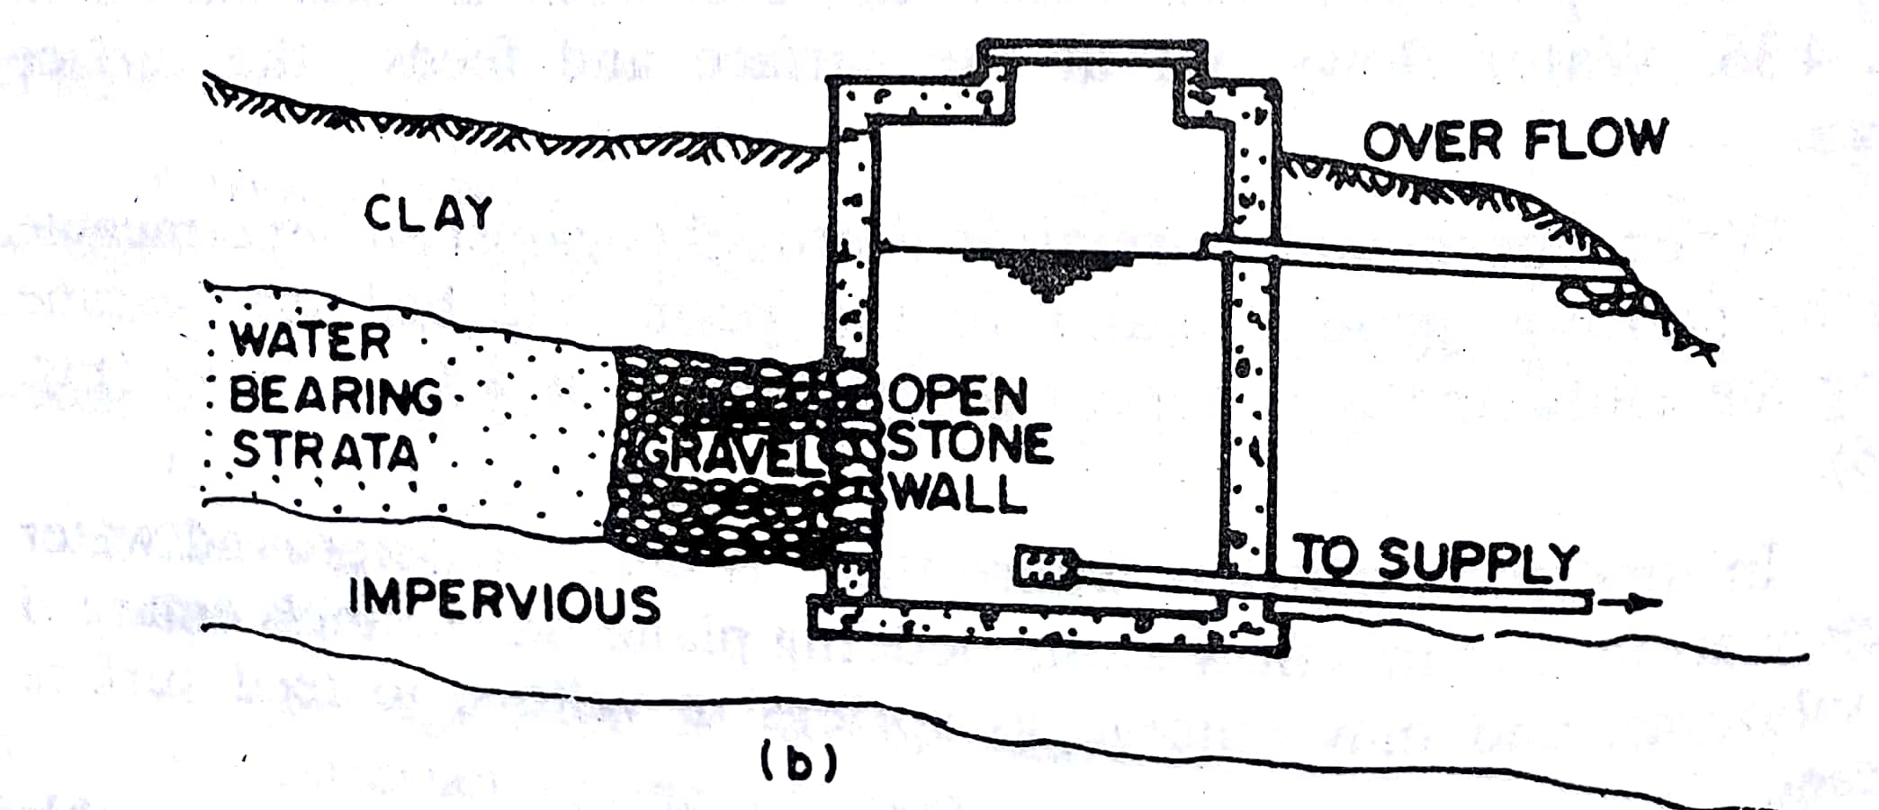
2.3.2 Springs
Ground water which flow out at the surface constitute spring.
Spring is the natural outflow of groundwater which appears at the ground surface as a current of stream of flowing water.
2 types of spring:
Gravity spring.
Non gravity spring.
Source : water supply engineering BC Punmia et all
34

Slide 36
Gravity spring
Results from water flowing under the hydrostatic pressure.
Types of gravity spring
Depression spring:
Formed due to emergence of water table where topography falls below its level.
Flow is variable due to rise or fall of water table so to meet such fluctuation a deep trench may be constructed near such spring.
Deeper the trench greater the certainty of continues flow.
Saturated ground above the elevation of trench bottom acts as storage reservoir.
35

Slide 37
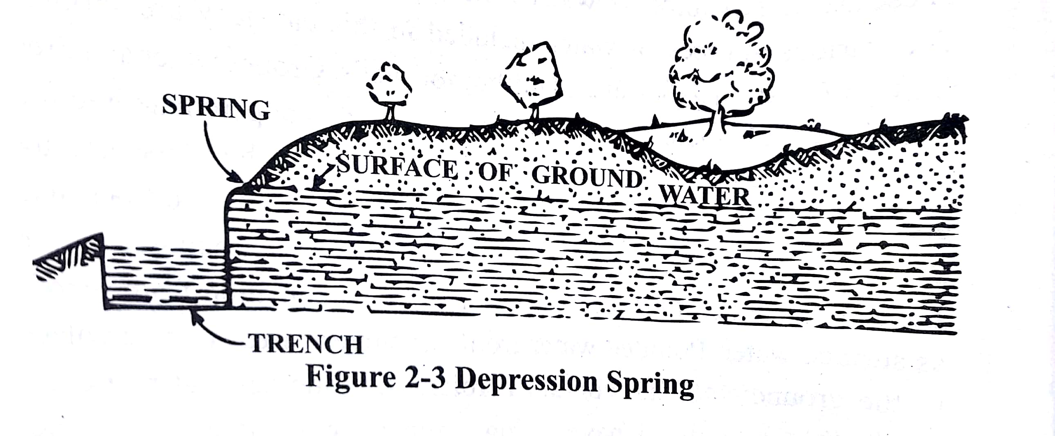
Depression spring
Source : Water Supply Engineering by Prof.Dr Bhagwan Ratna Kansakar
36

Slide 38
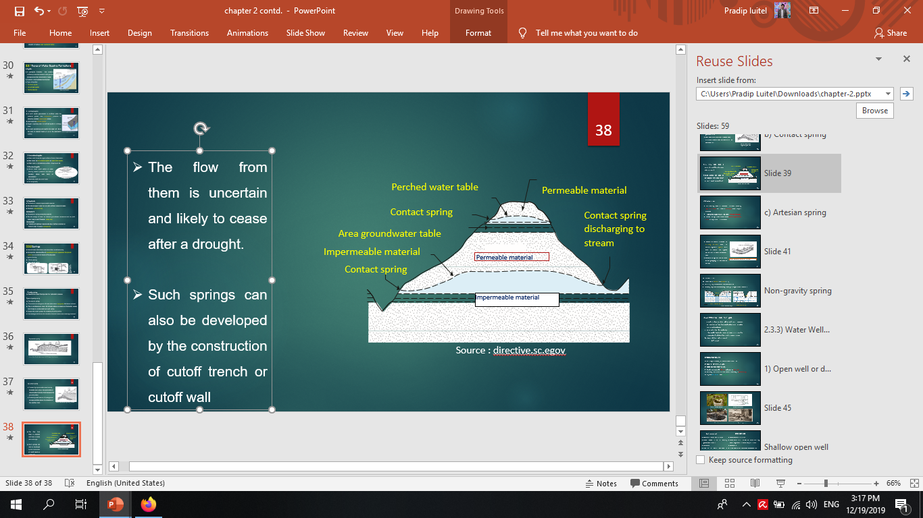
b) Contact spring
Created by a permeable water bearing formation over lying a less permeable or impermeable formation that intersects the ground surface.
Relatively small amount of underground storage available above the elevation of the overflow crest.
Source : directive.sc.egov
37

Slide 39
c) Artesian spring
The flow from them is uncertain and likely to cease after a drought.
Such springs can also be developed by the construction of cutoff trench or cutoff wall
Water-bearing bed is confined between relatively impervious strata and water is recharged from a higher elevation
The confined water is said to be under artesian pressure.
Artesian springs occur where these confined permeable strata are exposed near the surface.
38

Slide 40
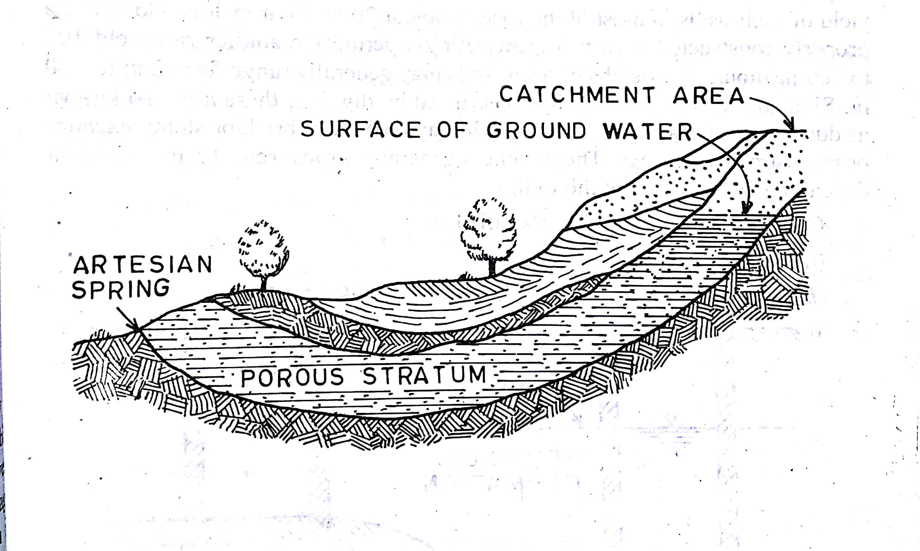
Springs may also occur where the confining formation over the artesian aquifer is ruptured by a fault or where the aquifer discharges to a lower topographic area.
Artesian springs can be sensitive to the pumping of wells located nearby.
Source: Water supply engineering, P.N. modi
39

Slide 41
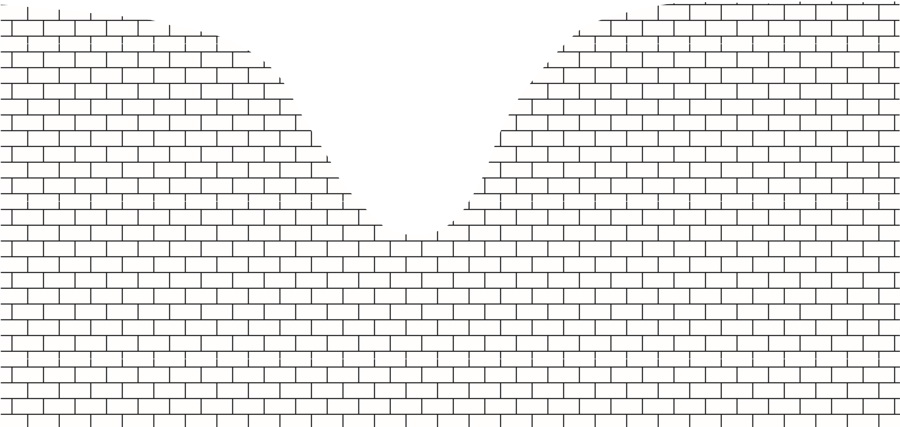

Non-gravity spring
These include volcanic and fissure spring.
Volcanic spring are associate with volcanic rocks.
Fissure springs fracture extending to the great depth in the earth crust.
s
G
r
o
u
n
d
w
a
t
Springs
e
r
t
a
b
l
e
Stream
Groundwater table
Springs
Springs in jointed limestone
Groundwater in joints and in scoriae between flows
40
Source : directive.sc.egov

Slide 42
2.3.3 Water well and their types
A well is a hole or shaft, with or without a supporting casing, extending from the ground surface to or into water-bearing earth materials.
permit extraction of groundwater.
If the aquifer is artesian, pumping requirements are less or precluded if sufficient flow is at the ground surface.
Two types : 1. Open well or dug well
2. Tube well
41

Slide 43
1) Open well and dug well
Have large diameter , low yield and not very deep.
Diameter vary from 0 to 10m.
Depth may vary from 0 to 20m.
Usually constructed by digging so known as dug well.
Wall may be of brick masonry concrete masonry or precast rings.
2 types: shallow well and deep well.
42

Slide 44
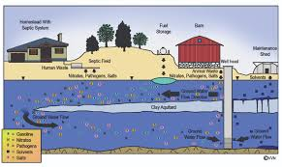
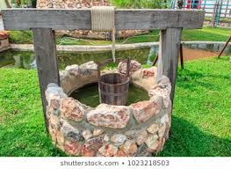
Source:- shutterstock.com
Source: agrilifeextension.tamu.edu
43

Slide 45
Shallow open well
Deep open well
Rest on top water bearing strata.
Draw water from surrounding permeable material.
Less yield.
Quantity of water available is uncertain due to fluctuation of water.
Use for an individual household.
Open to risk of contamination.
Dissolve impurities are less.
Rest on impervious strata.
Draw water from permeable formation lying below impervious strata through bore hole.
More yield.
Quantity of water available is more uniform.
Use for small community.
Free from suspended particle and bacterial contamination.
Dissolve impurities are more.
44

Slide 46
Gravity well
Artesian well
The surface of water in the aquifer outside and surrounding the well is at atmospheric pressure.
Water flow under the pressure in the well.
Mostly located in the valley of mountain.
Artesian well.
Artesian flowing well.
45

Slide 47
2) Tube Well
Long pipe sunk into the ground intercepting one or more water bearing strata.
Diameter 80mm to 600mm.
Shallow tube well depth limited to about 30m.
Yield maximum 20 cubic meter/hour.
Deep tube well depth limited to about 600m.
Yield more than 80 cubic meter/hour.
Strainer type tube well.
Cavity type tube well.
Slotted type tube well.
46

Slide 48
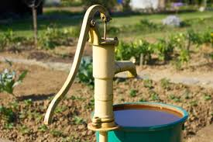
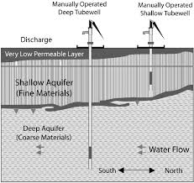
Source:- istockphoto.com
Source:- grettyimages.com
47

Slide 49
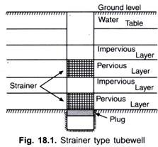
Strainer type tube well
Most common and widely used.
Pipe is assembly of strainer and ordinary pipe.
Strainer pipe rest on aquifer and ordinary pipe on
aquicludes.
common strainer consist of wire mesh.
Size of opening of wire mesh is D60 to D70 of
surrounding soil.
Source:-Wikipedia.com
48

Slide 50
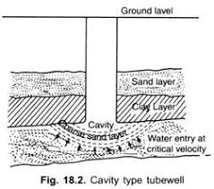
Cavity type tube well
Pipe sunk into the ground and rest on strong clay layer.
draw water from only from bottom.
Initially fine sand with water comes out and cavity is formed.
With increase of spherical area of cavity velocity is reduced and sand particle stops entering.
Only one particular aquifer can be tapped.
Source:-yourarticleibrary.com
49

Slide 51
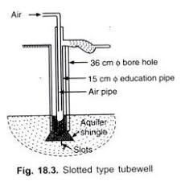
Slotted type tube well
Pipe is slotted for part of its length at one end and for the rest it is plain pipe.
Slotted portion is usually 5m long and penetrates confined aquifer.
Slot 25mm*3mm spacing 10 to 12 mm.
Prevent the entering of fine sand into the well by mixture of gravel and course sand.
Source:- yourarticlelibrary.com
50

Slide 52
Strainer type | Cavity type | Slotted type
Consist of strainer | No require of strainer | Consist of slots.
Tap more aquifer. | Tap one aquifer. | Tap one aquifer.
Surrounded by wire mesh | Cavity is formed at bottom. | Surrounded by gravel and Course sand
51

Slide 53
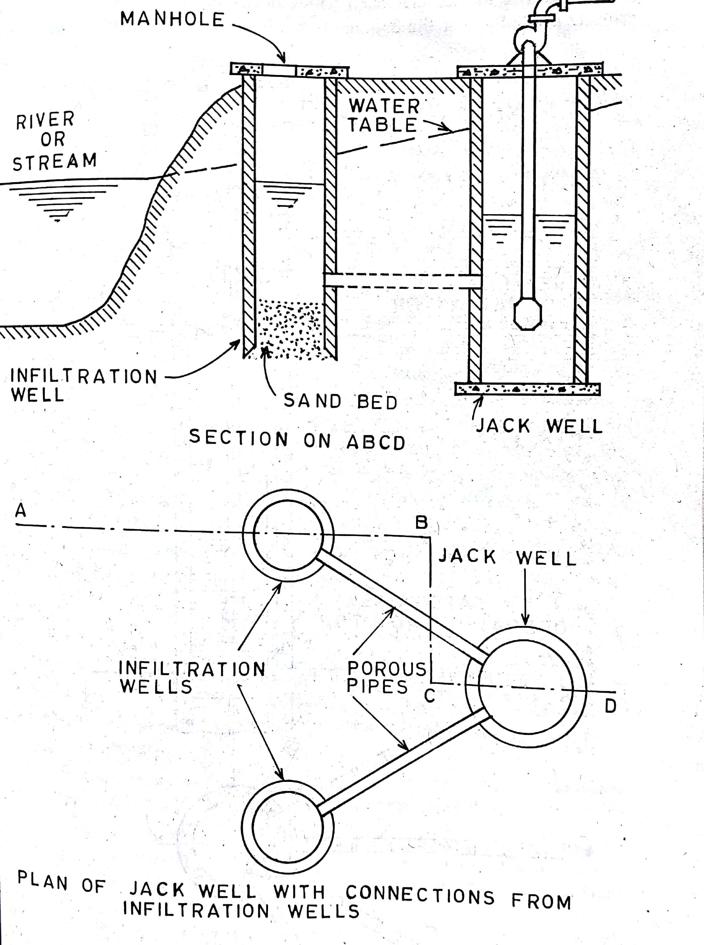
Infiltration Well
Shallow wells constructed in series along the bank of river to collect the water seeping through the bank.
Constructed by brick masonry with open joint.
Manhole provided for inspection purpose.
Series of well are connected by porous pipe to a jack well.
Water from jack well is pumped to treatment plant.
Source:- water supply ,enginnerering, PN modi
52

Slide 54
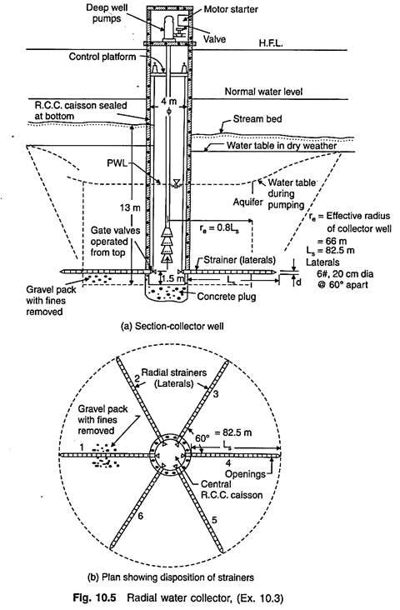
Collector Well
Consist of reinforced concrete caisson or well about 3 to 6 m diameter.
Horizontal screened pipe are projected radially near bottom.
Initial cost exceeds that of ordinary well, but have larger yield.
Used when large discharge is require but thin highly permeable aquifer is available.
Source:- pinterest.com
53

Slide 55
2.4 Selection of Water Sources
1. Location
Source should be near to community area.
If both surface water and ground water is available, use of surface source is preferred due to adverse environmental effects such as lowering of ground level.
Water should be conveyed through gravity.
2. Quantity of water
Sources should be sufficient to cater the demands of community even in the driest period.
All water is not allowed to be tapped for water supply system.
54

Slide 56
3.Quality of water
The water should be wholesome safe and free from pollution of any kind.
Treatment should avoided as far as possible.
4. Cost
Cost of system should minimized so that water can be supply at affordable price.
56

Slide 57
THANK YOU

